Slide 1



Mobile Price
Prediction
NeXT hikes IT Solution
by Deepa Pathak
DataWithDeepahttps://github.com/DataWithDeepa

Slide 2

Project Objective
Goal
Techniques
Analyze and predict mobile phone prices
Exploratory Data Analysis (EDA)
Models
Label Encoding, Machine Learning models

Slide 3



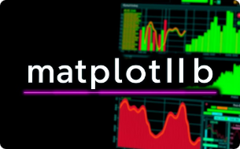


Tools & Libraries Used
Python
Pandas
NumPy
Matplotlib
A versatile, high-level programming language used for data analysis and modeling.
Powerful data manipulation and analysis library for structured data.
Core library for numerical computing with support for large multi-dimensional arrays.
Comprehensive plotting library for creating static, animated, and interactive visualizations.
Seaborn
Scikit-learn
Statistical data visualization library built on Matplotlib to simplify complex graphics.
Robust machine learning library for data mining and data analysis tasks.

Slide 4
Data Overview & Preprocessing
Dataset Shape
Sample Data
Rows: 2000+ | Columns: 20+
Brand
Model
Price
RAM
Preprocessing
Samsung
A12
150
4GB
Handling missing values
Brand extraction from model names
Apple
iPhone 12
700
6GB

Slide 5



Feature Engineering Steps
Label Encoding
IQR Outlier Removal
Convert categorical variables into numeric codes
Remove extreme price values to improve model accuracy

Slide 6
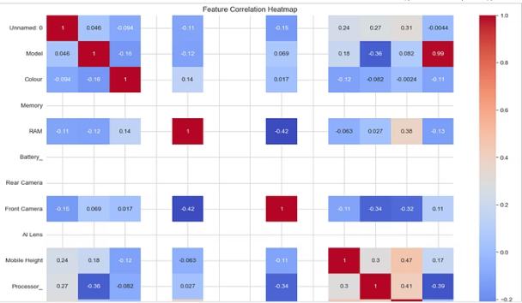
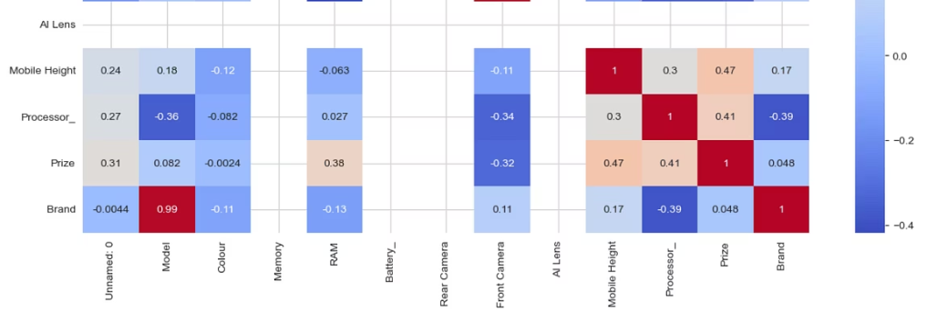
Correlation and Bivariate/Multivariate Analysis (Visualizations)

Slide 7
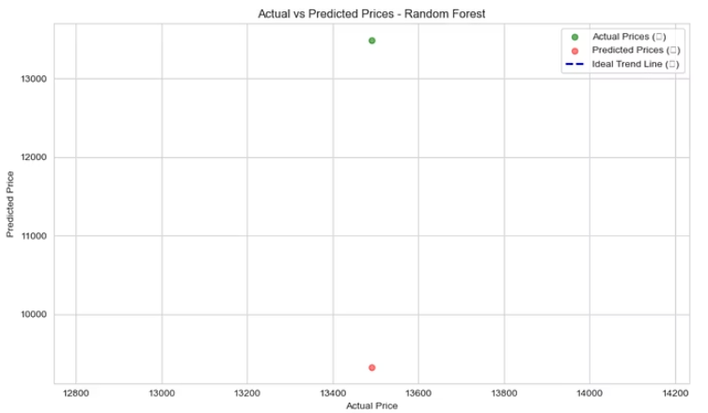
Model Evaluation & Comparison
Key Insights
Random Forest outperforms Linear Regression

Slide 8
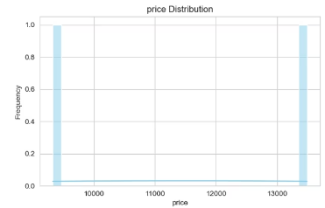
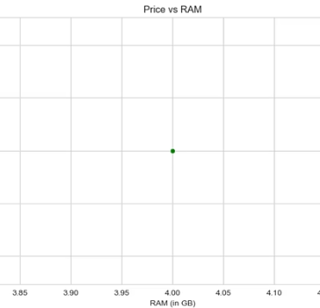
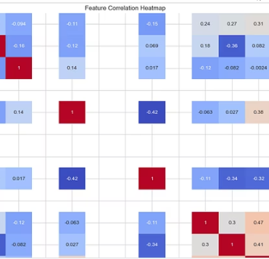
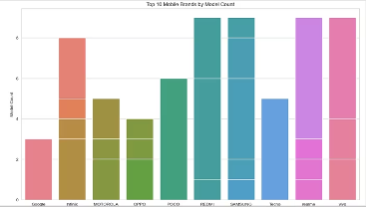
Exploratory Data Analysis Highlights
Brand Model Count
Price Distribution
Price vs RAM
Correlation Heatmap

Slide 9
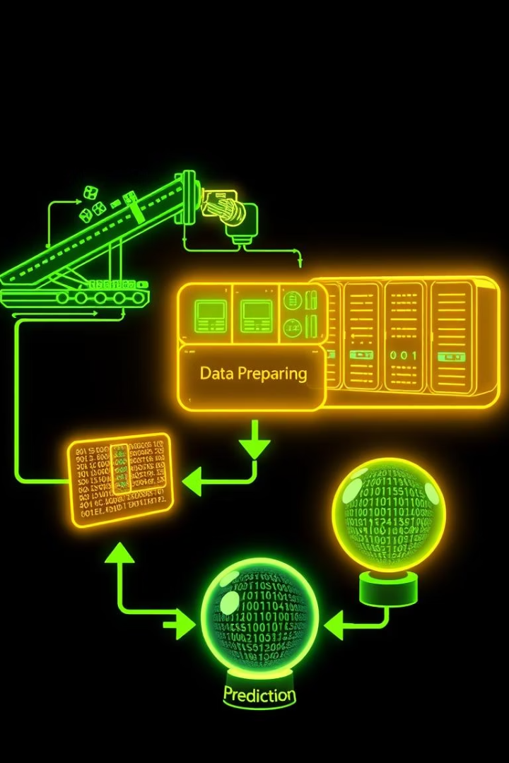
Model Building Process
Models
Linear Regression
Random Forest
Data Split
80% Training | 20% Testing
Training & Validation
Model fitting and performance tuning

Slide 10
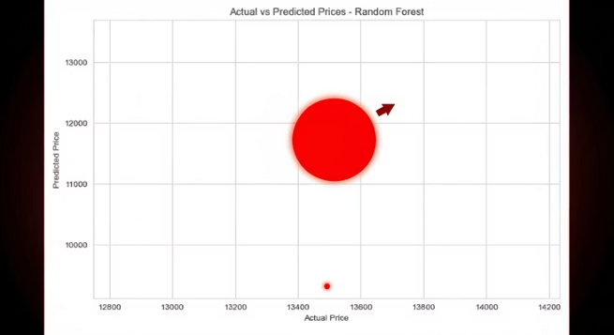
Model Evaluation & Comparison
Prediction vs Actual for Random Forest

Slide 11

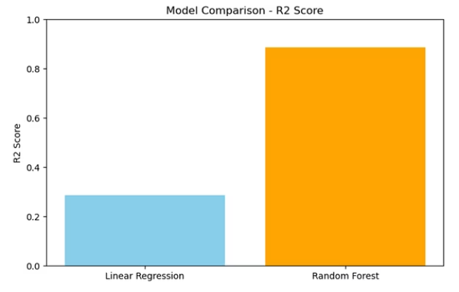
Model Comparison (R2 Scores)
The R2 score measures the proportion of variance explained by the model, indicating its predictive power.
A higher R2 value represents better model accuracy and fit to the data.
Comparing models using R2 score helps identify the best performing prediction approach for pricing estimation.

Slide 12



Thank you
Prediction Model Summary
Accurate Pricing Estimates Achieved
Best Model Implemented with Great Results

